Slide 1
Lecture 12:
Environmental Legislation in India
Course: Environment and Politics in India

Slide 2
Environmental Laws
WHERE do the laws come from?
  Constitution of India. Part IVA (Art 51A – Fundamental Duties; Art 48A – Directive Principles of State Policy)
  International Commitments. Beginning with UN Conference on Human Environment, Stockholm 1972
  42nd Constitutional Amendment, 1976

Slide 3
Part Four of the Constitution
Directive Principles
Non-Justiciable
Guidelines for State Policy and Adjudication
Lower to Fundamental Rights in importance
  Welfare State (Income, Social equality)
  Panchayats, local self-government
  Right to education, work, public assistance
  Humane working conditions
  Uniform Civil Code
  Protect forests and wildlife; historical heritage
  Uplift SC, ST, weaker sections
  Improve public health; child care
  Cow Protection
Part Four A: Fundamental Duties

Slide 4
Environmental Laws
  TIMELINE:
  1972: National Council for Environmental Policy and Planning (within DST)
  1974: Central Pollution Control Board (CPCB)
  1985: Ministry of Environment and Forests (MoEF):
  MANDATE:
  Prevention and control of pollution
  Survey of flora, fauna, forests and wildlife
  Afforestation and regeneration of degraded areas
  Conservation and Protection of the environment, ensuring the welfare of animals

Slide 5
Environmental Laws
Some important ACTS:
1972: Wildlife Protection Act
1974: Water (Prevention and Control of Pollution) Act
1980: Forest Conservation Act
1981: Air (Prevention and Control of Pollution) Act
1986: Environment Protection Act
1989: Hazardous Wastes (Management and Handling) Rules
1991: Public Liability Insurance Act
2002: Biological Diversity Act
2010: National Green Tribunal Act
2011: Coastal Regulation Zone Notification

Slide 6
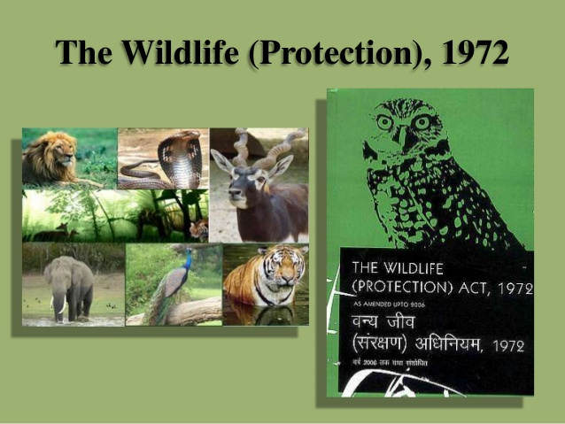
Wildlife Protection Act
Passed in 1972
Objectives
  Protecting plants/wildlife/ecologically sensitive areas
  Controlling poaching/smuggling /illegal trade
  Setting up/management of National Parks and Wildlife sanctuaries
  Amended in 2003 to make it more stringent
  Various schedules with varying degrees of protection. POLITICS?

Slide 7
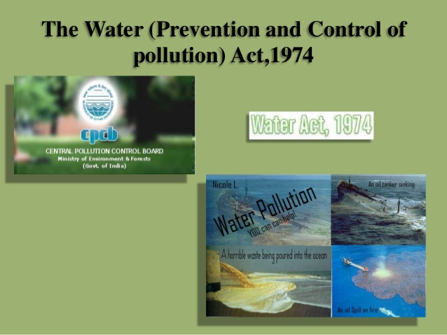
Water Act
Passed in 1974
Objectives
  Prevention of water pollution
  Establishment of ‘Boards’ to ensure regulation
  Designing limits/penalties for BOD/COD
  1977: Water Cess Act
  Amended in 2003
  POLITICS? On regulations, penalties, constitution/powers of Boards

Slide 8
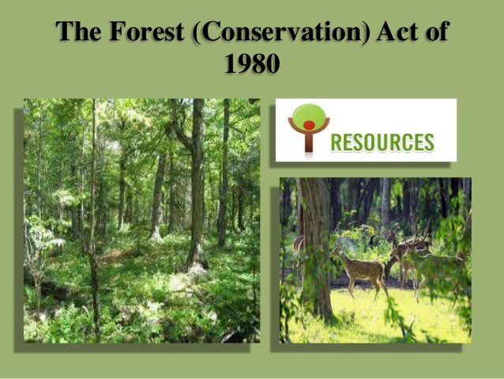
Forest Conservation Act
Passed in 1980
Objectives
  Control/protection of forests
  Preventing/controlling diversion of forests to non-forest uses
  Indian Forest Act 1927: Decides on levies/revenues from forest produce
  POLITICS? Permission for forest diversion. Rules over use of forest produce

Slide 9
Air Act
Passed in 1981
Objectives
  Control of air pollution
  Drafting permissible limits
  Monitoring
  Penalties
  POLITICS? Closure of existing units?
  1996: Closure of industrial units in/around Delhi

Slide 10
Environment Protection Act (EPA)
Passed in 1986
Passed after Bhopal Gas tragedy, to fills gaps in legislation
TWO main approaches: long term approach/planning etc., setting the template for handling immediate crisis
Objectives
  Umbrella Act, encompassing Air/Water/Soil/Forest etc.
  Addressing issues that are NOT covered by other Acts
  Wide-ranging powers, coordinating with other legislations /bodies
  Penalties

Slide 11
Hazardous Wastes Act
Passed in 1989
Objectives
  Controlling production/storage/use/movement of ANY hazardous substance
  Covers Biomedical waste, e-waste, municipal solid wastes, effluents, batteries
  POLITICS?
  EXAMPLE: Asbestos

Slide 12
Public Liability Insurance Act
Passed in 1991
Objectives
  Protection to victims of accidents
  Decides WHO pays in case of accident, WHO insures.
  POLITICS?
  EXAMPLE: 2009 Nuclear Deal

Slide 13
Biological Diversity Act
Passed in 2002
Based on UN Convention on Biological Diversity
Objectives
  Allows rights of individual countries over OWN biological resources. CONTEXT? Battles over Turmeric/Basmati rice/Neem
  Documentation of biological resources (including indigenous knowledge)
  Conservation of biological resources
  POLITICS?

Slide 14
National Green Tribunal Act
Passed in 2010
First dedicated ENVIRONMENTAL court
3rd in the world, after Australia and New Zealand
Objectives
  Fast-track resolution of environmental disputes
  Over and above HC/SC
  POLITICS?
  EXAMPLE: Art of Living case

Slide 15
Coastal Regulation Zone Act
Passed in 2011
Objectives
  River regulation AND coastal regulation
  Livelihood security to fishing communities
  Protection of eco-sensitive coastal zones
  Prevention of uncontrolled construction in coastal areas
  Preventing natural hazards
  Addressing impacts of climate change
  POLITICS?
  EXAMPLE: Uttarakhand floods. Tourism/development versus Environment

Slide 16
Major Issues
  Debates around law-making:
  State governments versus Union/Centre (EXAMPLES: PESA)
UNITARY
FEDERAL
All powers concentrated in single government
  Centralised
  Decentralised
  Regionalised
Power distributed between multiple levels of government
  Centralized
  Decentralized
Based on principle of shared rule plus self rule.
  Linked to democracy, sharing, diversity and the maintenance of distinctive identities
Separation of powers-constitution

Slide 17
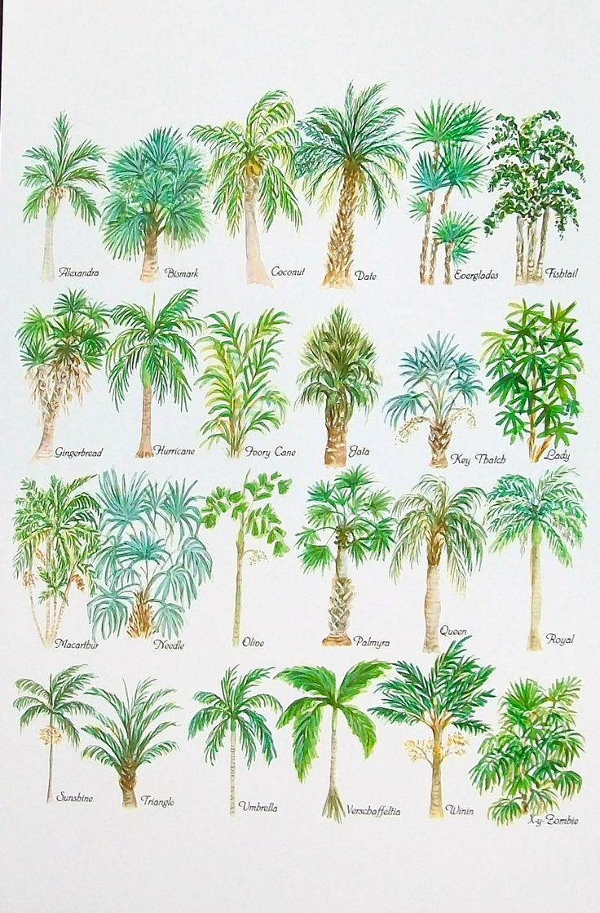
Varieties of Federations
Federal idea can take DIFFERENT forms.
No ONE model of federalism.
Depends on:
  Historical circumstances
  Emergent demands and needs of societies
  Nature of population, diversity and so on

Slide 18
Models of Federalism
Coming Together Model
  where (more or less) sovereign states come together to create a common central government to which the states surrender some of their sovereignty
    United States
Holding Together Model
  A larger polity is subdivided into various sub-units that enjoy sovereignty over certain policy areas
    Belgium, India
Putting Together Model
  A large unit forcefully brings together previously independent units and takes away some of their sovereignty and allows some sovereignty in certain areas
  Former USSR, Yugoslavia

Slide 19
Historical Background
Why
Fear of disunity
Strong-centre model of federation
Federalism to suit India’s needs and requirements
Powerful central government to lead from the front: economic, political, social
Protect India’s freedom
Partition and communal riots that followed
Migration and influx of millions of people
Invasion of Jammu and Kashmir
Problem of princely states
Danger of extremist violent groups

Slide 20
Other factors
Unification of Princely states
Goals of National Unity and Integrity, Democracy and Social and Economic development
Balanced regional development
Congress everywhere: One-party dominant
  Reinforced the centralizing component
Global circumstances

Slide 21
Major Issues
  Debates around law-making:
  Executive versus Judiciary (Markandey Katju and Air Pollution in Delhi)
  Other issues:
  Balancing various POLITICAL/ECONOMIC/SOCIAL interests
  EXAMPLES: Tiger conservation versus shikar/tourist lobby

Slide 22
Water Pollution Act
  Passed in 1974
  Took FIVE years to pass after the initial draft
    Was FIRST introduced in Parliament in December 1969
    Got a major boost after the Stockholm 1972 conference
    Opposition? Question of Federalism.
    ELEMENTS of the ideological/power struggles
      Part XI of the Constitution allows DISTRIBUTION of legislative/administrative/executive powers between Centre/Union/Federal government and state governments.
      Water: 17 in the STATE list, 56 in the UNION list. States responsible to handle water pollution.
      Active opposition from Maharashtra.
      SOLUTION? Formation of the CPCB/SPCBs. INSTITUTIONAL distribution of powers.

Slide 23
Air Pollution Act
  Passed in 1981
  Took EIGHT years to pass after the initial draft
  Possible Issues?
    Debate over Federalism
    Debate over the extent of air pollution. ‘Development’ versus Environment?
    Debate over WHO should pay, WHY they should pay and HOW much.
    EXAMPLE: Small versus Large industries

Slide 24
Wildlife Protection Act
  Passed in 1972, after much back-and-forth arguments
  Problems of Federalism
  “Our Fauna is already dangerously depleted. It is an asset to be cherished and conserved. In recent years, I have had to intervene more than once with the States in this matter. It is essential for the Centre to give a lead…” – Indira Gandhi
  Local communities versus Wildlife Conservation.
  Industrial Forestry versus Wildlife Conservation.
  Contractors Lobby versus Wildlife Conservation.
  Dams versus Wildlife Conservation. EXAMPLE: Silent Valley project.
  ‘Scientific study’ of wildlife versus Wildlife Conservation.
  EACH declaration of a ‘NATIONAL’ Park saw much lobbying/counter-lobbying between ACTIVISTS, STATES and the CENTRE.
  EXAMPLE: Dudhwa National Park and Billy Arjan Singh
  Crucial ROLE of powerful individuals and social networks.

Slide 25
Forest Conservation Act
  1976: Forests AND Protection of Wild Animals and Birds were moved from the STATE to the CONCURRENT list. WHY?
  March 1980: Meeting with Conservationists. Concern over dwindling forest cover, NO discussion on any Bill/Act.
  June 1980: Draft law drafted by Samar Singh.
  October 1980: Article 123(1), Ordinance passed.
  December 1980: Bill passed.

Slide 26
Forest Conservation Act
  Notwithstanding anything contained in any other law for the time being in force in a State, no State Government or any other authority shall make, except with the prior approval of the Central Government, any order directing –
  That any reserved forest (within the meaning of the expression “reserved forest” in any law for the time being in force in that State) or any portion, thereof, shall cease to be reserved;
  That any forest land or any portion thereof may be used for non-forest purposes.
  Explanation: For the purpose of this section “non-forest purpose” means breaking up or clearing of any forest land or portion thereof for any purpose other than reafforestation.
  - Abstract from Draft FCA Bill

